Slide 1


Multivariate Geochemical Classification on Stratigraphic Layers – Model Exploration and Experimentation
Case study: bushveld complex, South Africa.
By: Muhammad ziad

Slide 2
Flow Chart Presentation
Introduction
5
Results and Discussion
6
3
Objectives
2
Methodology
Analysis and Model Processing
4
1
Start
Conclusion
End

Slide 3
Introduction Reference Used:
Main Reference:
Bachmann, Kai, Peter Menzel, Raimon Tolosana-Delgado, Christopher Schmidt, Moritz Hill, and Jens Gutzmer. "Multivariate geochemical classification of chromitite layers in the Bushveld Complex, South Africa." Applied Geochemistry 103 (2019): 106-117. (Note: For the secondary publication, see https://www.hzdr.de/publications/PublDoc-13336.pdf, CC BY-NC-ND)
Additional Reference:
Raimon Tolosana-Delgado, Juan Jose Egozcue, Vera Pawlowsky-Glahn. "Modeling and Analysis of Compositional Data".h 20, ): Wiley. ISBN: 978111844306
Egozcue, Juan Jose; Pawlowsky-Glahn, Vera; Mateu-Figueras, Gloria; Barcelo-Vidal, Carles (2003), "Isometric logratio transformations for compositional data analysis", Mathematical Geology, 35 (3): 279–300, doi:10.1023/A:10238182146144
Rollinson, H. R. and Peace, V, (2021). Using Geochemical Data: Evaluation, Presentation, Interpretation (2nd ed.). Routledge.
https://online.stat.psu.edu/stat504/lesson/8

Slide 4

Introduction Geochemical Data
Geochemical data refers to the chemical composition of Earth's materials, such as rocks, soils, sediments, and water, measured to understand geological processes. This data is often used to trace the origin, distribution, and interaction of elements within the Earth’s crust, aiding in studies of mineral resources, tectonics, and environmental changes.
Example: analyzing major, trace, and rare earth elements, geochemists can infer rock formation histories, weathering processes, and ore deposit genesis.
Output form (mostly): classification

Slide 5
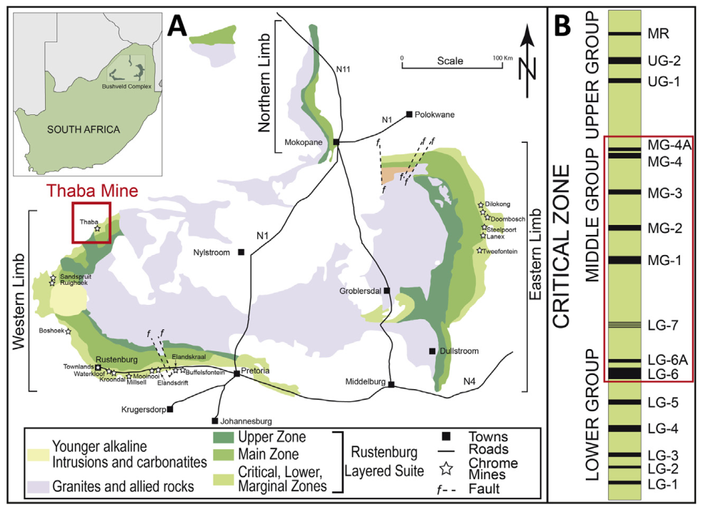
Introduction Geological Context
(Geological Map of the Bushveld Complex. The location of the Thaba mine is marked in red.
(B) Stratigraphic column of the Critical Zone showing the positions of the major chromitite layers and of the Merensky Reef (MR) )
[1]
The Bushveld Complex, the world's largest layered mafic-ultramafic intrusion, accounts currently for 45% of global annual chromite ore production and contains 40% of global chromite reserves (USGS, 2018). Besides vast resources of chromite, the Bushveld Complex also contains the largest global resource of platinum-group elements (PGE) as well as significant resources of Ni and Cu (e.g., Von Gruenewaldt, 1977; Maier et al., 2013).

Slide 6
Objectives
In this study we propose such a classification scheme based on linear discriminant analysis using:
a large database covering a significant number of chromitite layers, and
considering the compositional nature of whole rock chemical analyses of major element oxides and PGE (Kaufmann et al., 2018, in [1])
For this project, I will to make my hands-on experience on exploring the alternative model compared to the main model cited on paper (LDA) with the following Supervised Machine Learning (or, multivariate analysis) Model:
Random Forest Classification
Bagged Decision Tree Classification
Multinomial Logistic Regression

Slide 7
Objectives
Besides of that, in this project before conducting the modelling step, The focus of the data preprocessing part will be in the compositional analysis factor and explore mathematical basis of choosing this kind of method:
Data wrangling for preprocessing and cleaning the training, valid, and test data
Exploring other efficient classification model
Mathematics behind Isometric Log Ratio Transformation (Methods which chosen on the paper, and the importance of this) and Multinomial Logistic Regression

Slide 8
Methodology
In the original academic paper, the authors mentioned that they are using R language, with addiitonal packages "MASS" and "compositions" with function lda and function ilr
In this experimentation study, we will using Python language with additional packages scikit-bio library in “composition” with function ilr and closure, and various machine learning module in scikit-learn for multivariate analysis
For data analysis purposes the process will be conducted on Jupyter Notebook (.ipynb form) from Anaconda Navigator Platform, while the full code(.py form) can be accessed in my Github Platform.
Note: Data Splitting technique from the original paper and this project probably different different

Slide 9
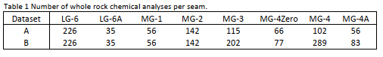
Analysis and Model Processing (Pre-Processing Step – Data Preparation)
As our first step, the authors mentioned there are filterization of the dataset beforehand for any missing values (such as “not analysed” or “below the detection limit”) among the major element oxides and the PGE. [1]
The second step is, due to limited available information all layers represented by less than 30 samples with complete records were not further considered. This included the layers LG-1 – LG-5 and LG-7 (totalling N = 12 cases). [1]
The remaining data for eight different chromitite layers, namely (stratigraphically upwards):
LG-6, LG-6A, MG-1, MG-2, MG-3, MG-4Zero (MG-4Z), MG-4, and MG-4A
Au contents are similar in all chromitite layers, with concentrations close to the detection limit and very small variability. Hence, Au was excluded from further consideration [1]

Slide 10
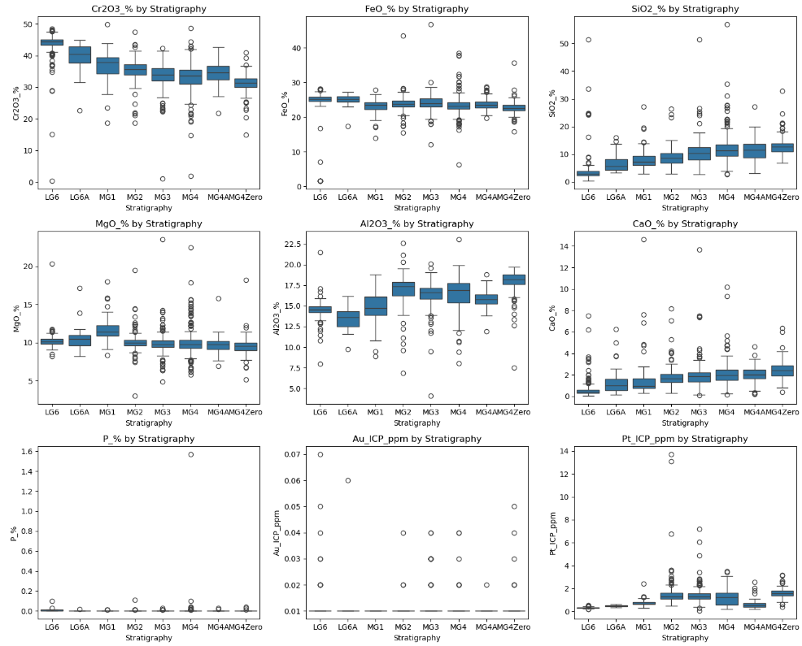
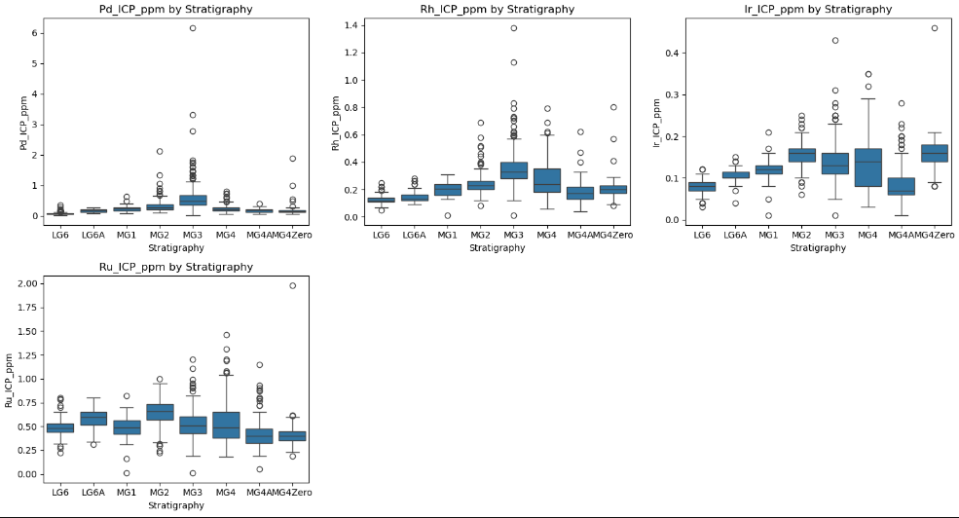
Analysis and Model Processing (Pre-Processing Step – Box Plot)
Box Plot (Initial Data)

Slide 11
Analysis and Model Processing (Pre-Processing Step – Work Flow)

Slide 12
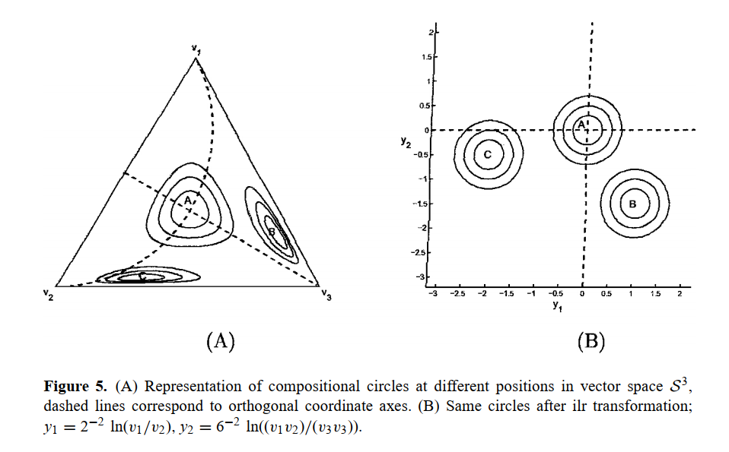
Analysis and Model Processing (Pre-Processing Step: Data Transformation)
Directly processing compositional data is not appropriate because it can lead to misleading results due to the closed nature of compositional data.
In geological context, a rock composed of different minerals may be a compositional data point in a sample of rocks; a rock of which 10% is the first mineral, 30% is the second, and the remaining 60% is the third would correspond to the triple [0.1, 0.3, 0.6].
[3]

Slide 13
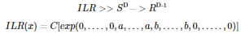
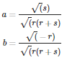
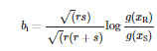
Analysis and Model Processing (Pre-Processing Step: Isometric Log Ratio Data Transformation)
The isometric log ratio (ilr) transform is both an isomorphism and an isometry where:
where series of first 0 can be declared as k, series of a can be declared as r, and series of b can be declared as s, and series of first 0 can be declared as t.
Each vector in the basis would be determined as:
Then, the elements within each vector are given as follows:
Once the basis of is built, the ilr transforms can be calculated as
where each element in the ilr transformed data is of the following form
where xB and xS are the set of values corresponding to the tips in the subtrees R and S
In short, we can consider ILR transformation can be aligned with PCA techniques in terms of reducing dimensionality without losing significant information of the dataset

Slide 14
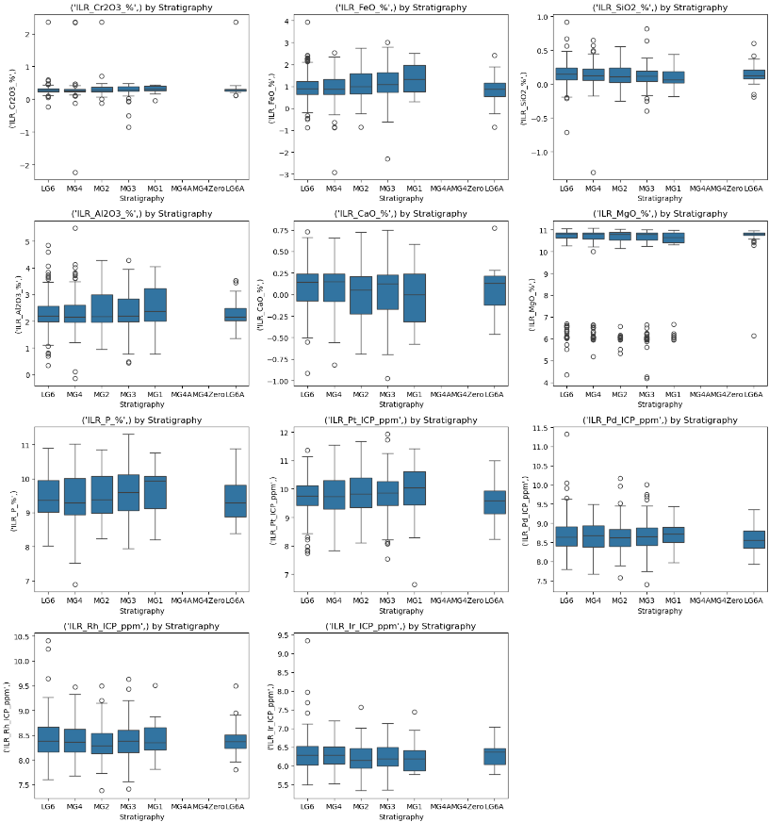
Analysis and Model Processing (Pre-Processing Step: – Box Plot)
Box Plot (Transformed Data)

Slide 15
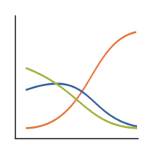
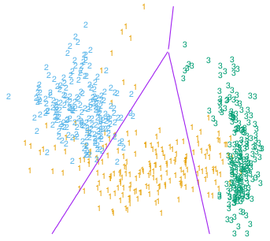
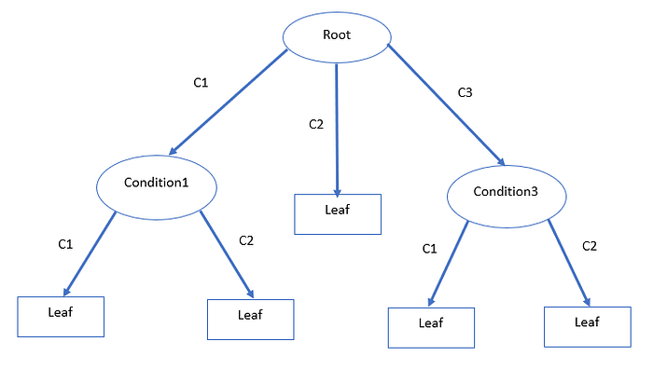
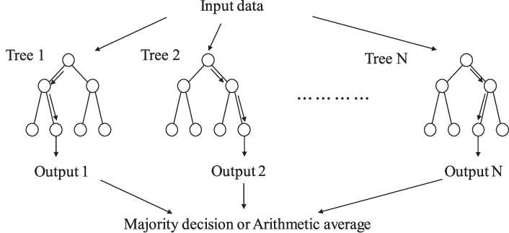
Analysis and Model Processing (Modelling Step – Used Models)
Models used:
Random Forest
Decision Tree – Bagging
Multinomial Logistic Regression
LDA (with default solver and least-square solver)
1
2.
3.
4.

Slide 16
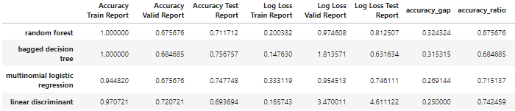
Result and Discussion (Comparing Each Model Score)
Methods used (score):
Accuracy
Log Loss
For each classes:
ROC-AUC curve (OvR)

Slide 17
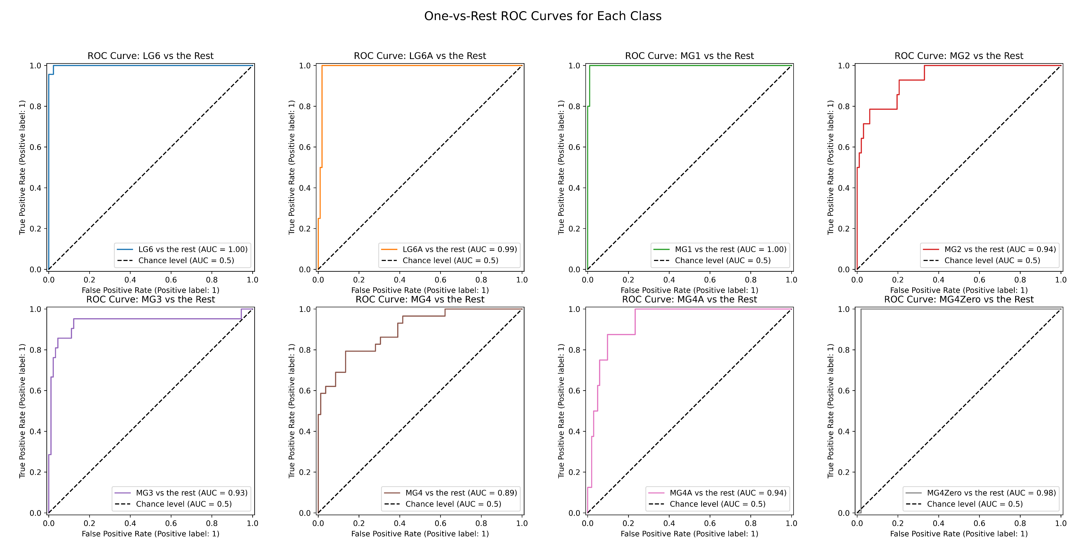
Result and Discussion (Comparing Each Model – Multinomial Logistic Regression)
Methods used (score):
Accuracy
Logarithmic Loss
For each classes:
ROC-AUC curve (OvR)

Slide 18
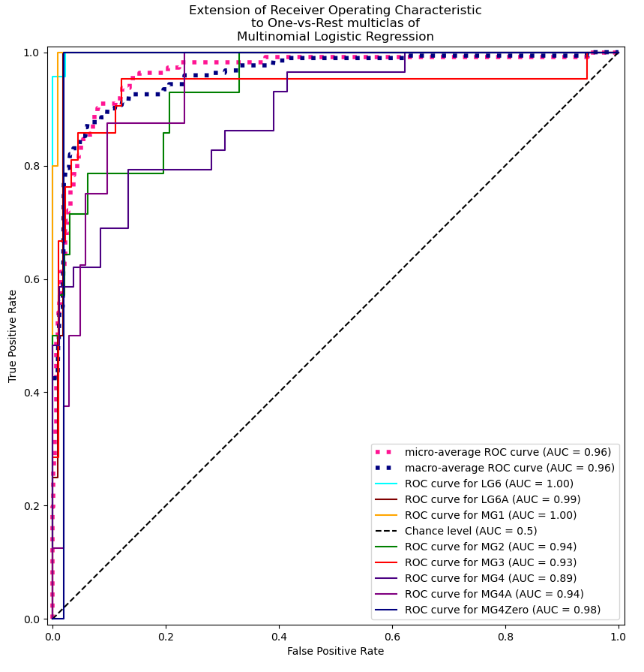
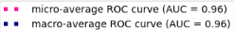
Result and Discussion (Comparing Each Model – Multinomial Logistic Regression)
Methods used (score):
Accuracy
Logarithmic Loss
For each classes:
ROC-AUC curve (OvR)

Slide 19
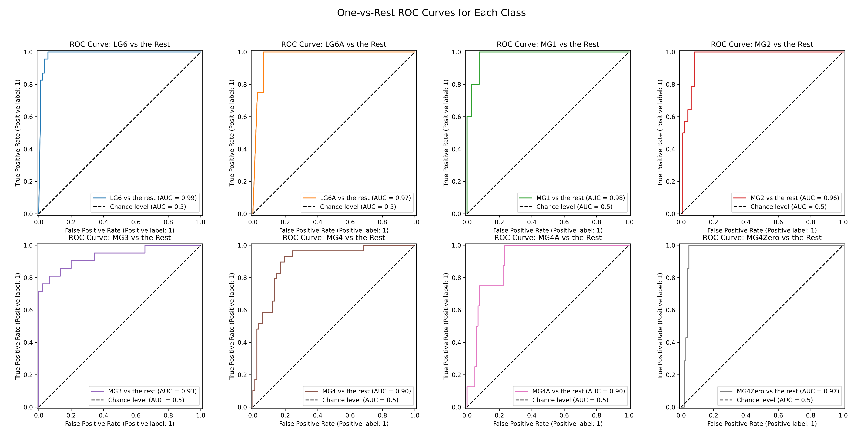
Result and Discussion (Comparing Each Model – Linear Discriminant Analysis)
Methods used (score):
Accuracy
Logarithmic Loss
For each classes:
ROC-AUC curve (OvR)

Slide 20
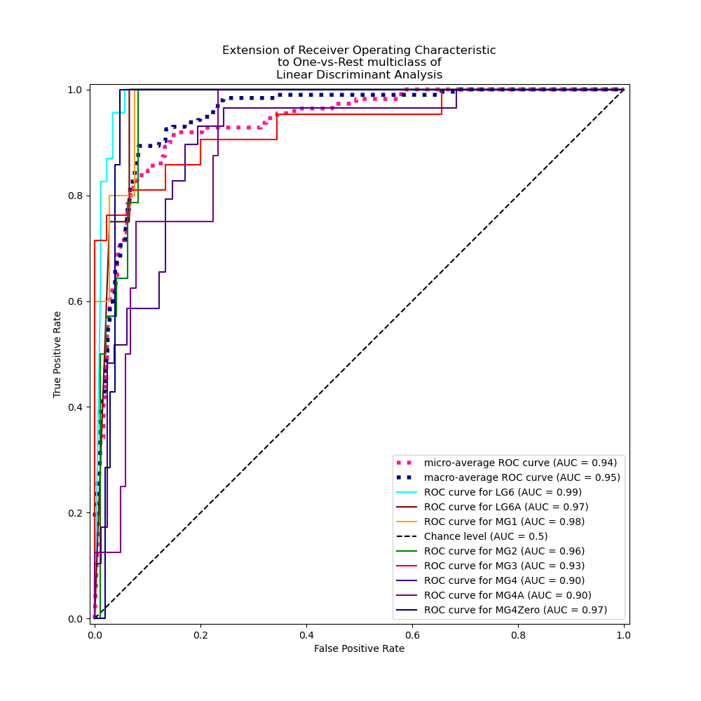
Result and Discussion (Comparing Each Model – Linear Discriminant Analysis)
Methods used (score):
Accuracy
Logarithmic Loss
For each classes:
ROC-AUC curve (OvR)

Slide 21
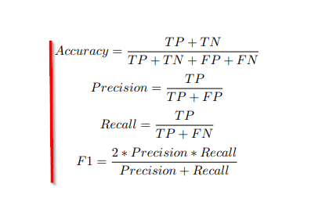
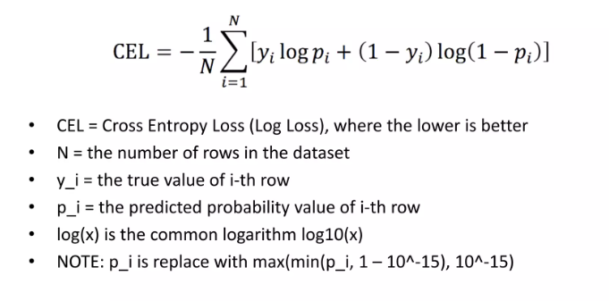
Result and Discussion (Comparing Each Model – The Difference and Its Significance)

Slide 22
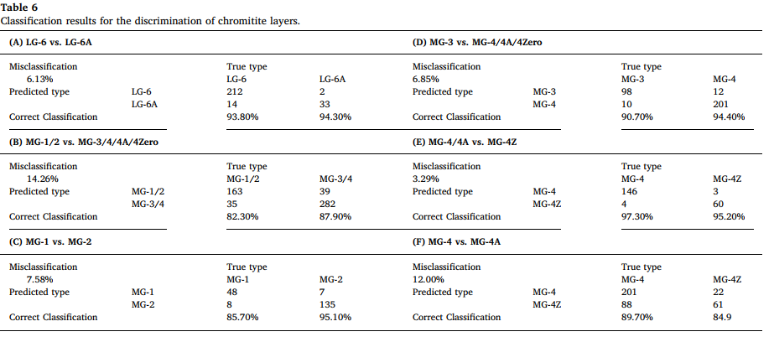
Result and Discussion (Comparing Each Model – LDA Report (From Paper)

Slide 23
Conclusion
We can not simply use simple standardization of the data preprocessing since the nature of data itself is compositional.
Random Forest and Decision Tree is not preferable in this case due to their vulnerability with data overfitting, although works pretty well in training dataset. It can be proven while we try to do data validation by compare valid dataset to training dataset
The Author chooses Linear Discriminant Model because it’s consistency with the overall performance of accuracy. Although the dataset separation method are different, it is proven while we try to do data validation by compare valid dataset to training dataset
Multinomial Logistic Regression is a good alternative if we considering logarithmic loss to evaluate the model’s confidence in predictions, since it provides a continuous metric for probabilistic classifiers and is ideal when we want to measure the model’s uncertainty along with correctness.

Slide 24
“But if the succession of worlds is established in the system of nature, it is in vain to look for anything higher in the origin of the earth. The result, therefore, of our present enquiry is, that we find no vestige of a beginning,—no prospect of an end.”
- James hutton, 1788 (on theory of the earth)

Slide 25
“Thank You.”
Muhammad ziad, in the future (on his future books ☺)

